Slide 1
Unreal advanced
multiplayer

Slide 2
Dedicated server
Dedicated server - a type of hosting, in which the client is completely provided with a separate physical machine.

Slide 3
DOWNLOAD the SOURCE

Slide 4
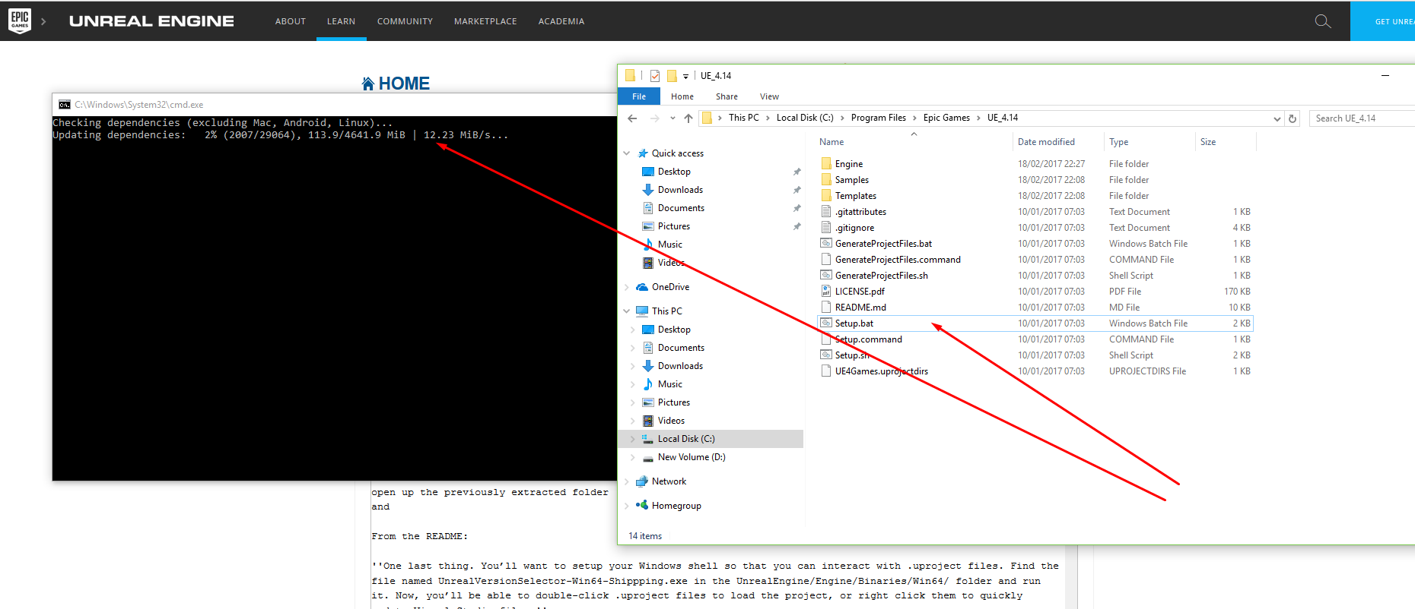
Build the engine

Slide 5
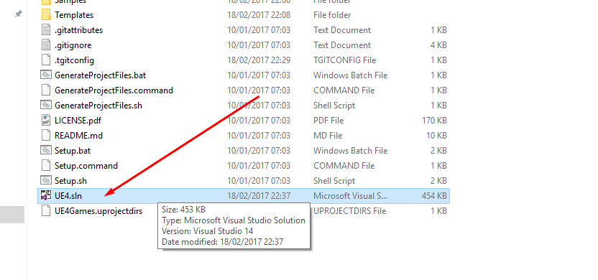
Build the engine
Run GenerateProjectFiles.bat

Slide 6
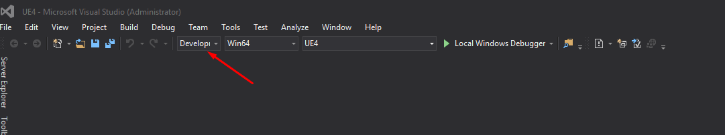
Build the engine

Slide 7
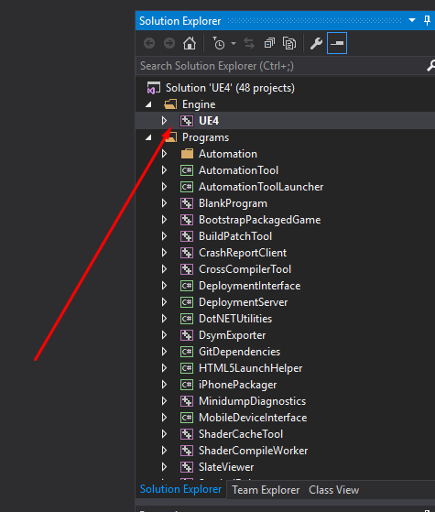
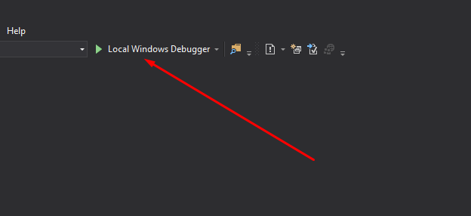
Build the engine

Slide 8
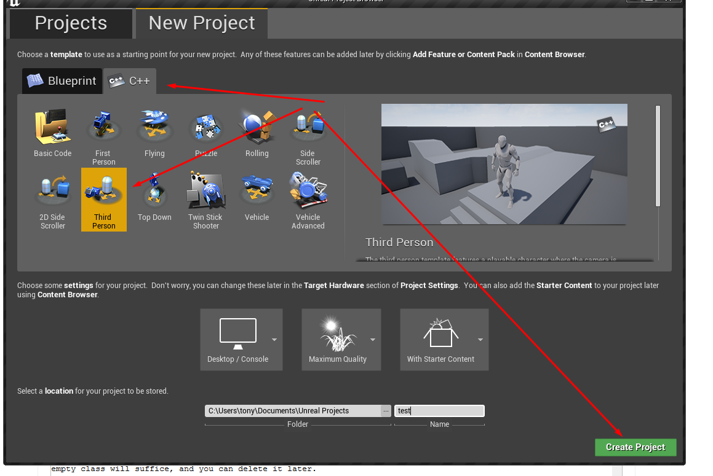
Create a new project

Slide 9
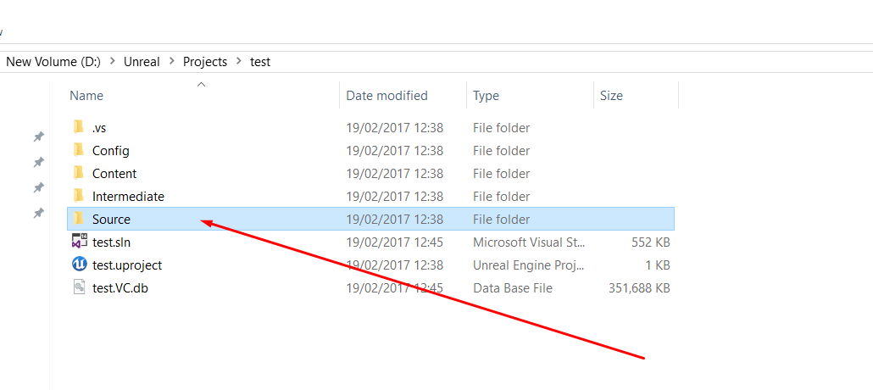
Edit the project

Slide 10
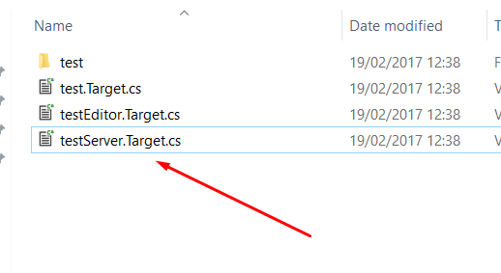
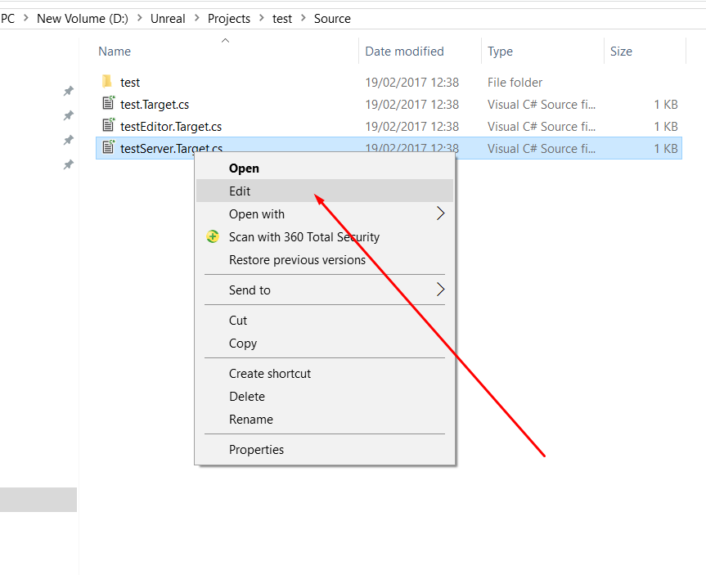
Edit the project

Slide 11
Edit the project
next you have to make 3 changes to the file
first find this line of code at the top
public class ShooterGameServerTarget : TargetRules
and change it so that it has your game name instead so in my case my game is called test so i would change the line of code to this
public class testServerTarget : TargetRules
next underneath it find this line of code and do the same as before and change the name to match your game
public ShooterGameServerTarget(TargetInfo Target)
so again in my case my game name is test so i would change this line of code to this
public testServerTarget(TargetInfo Target)
and finally find this line of code and do the same as before and change the name to match your game
OutExtraModuleNames.Add("ShooterGame");
so again in my case my game is called test so i would change this line of code to this
OutExtraModuleNames.Add("test");

Slide 13
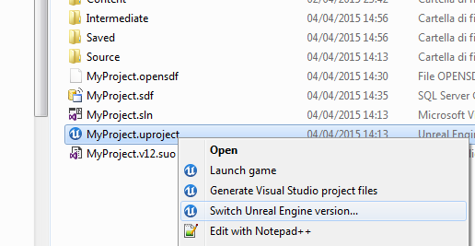

Slide 14
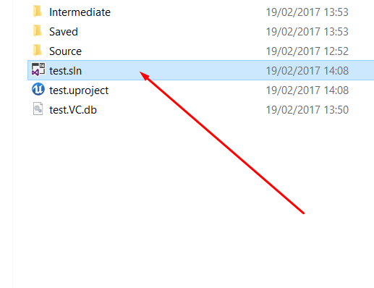

Slide 15
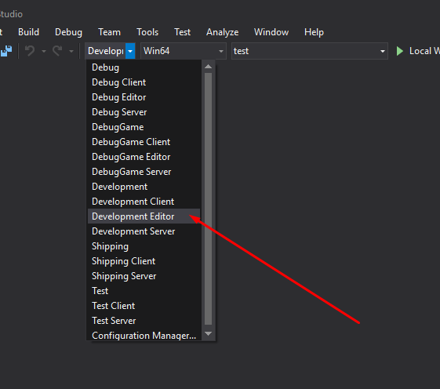
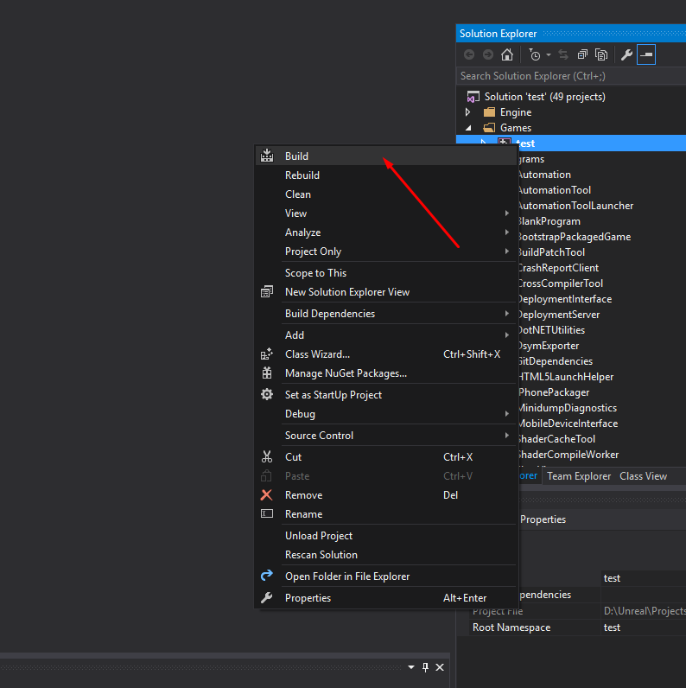

Slide 16
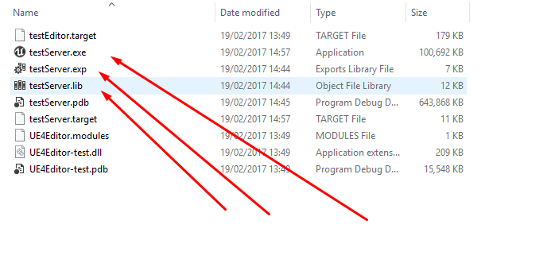

Slide 17
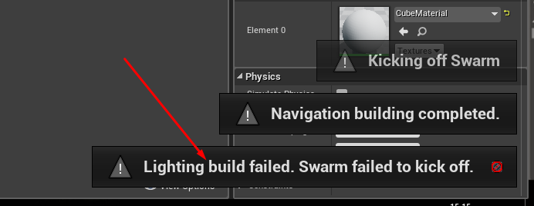
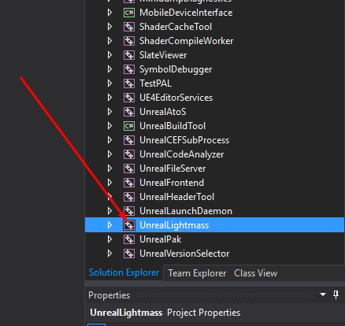

Slide 18
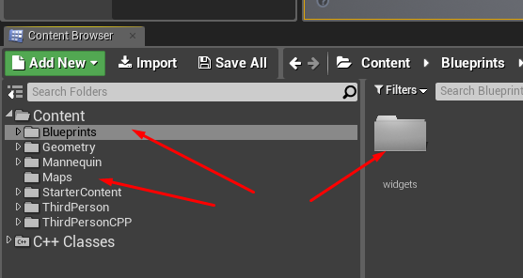
Prepare the project

Slide 19
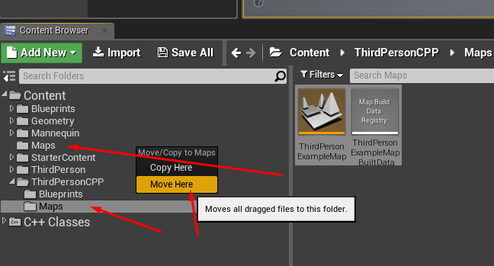

Slide 20
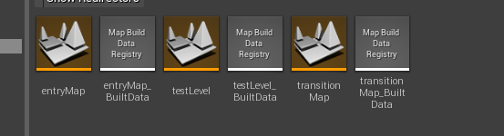

Slide 21
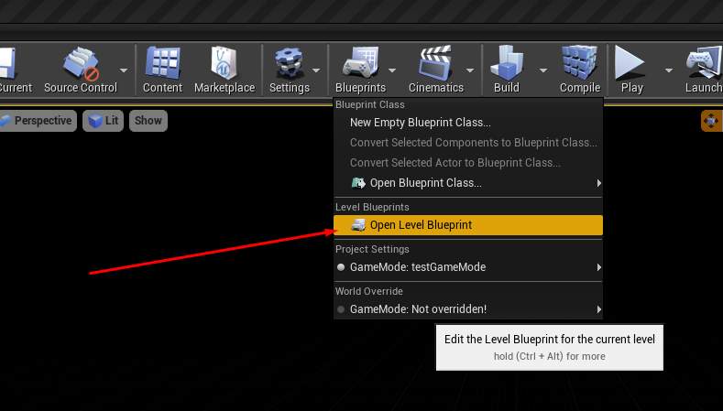

Slide 22
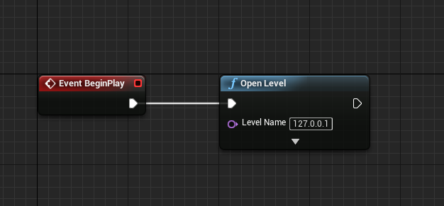

Slide 23
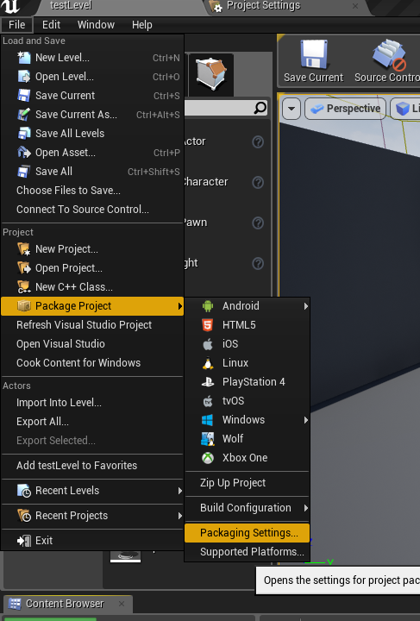

Slide 24
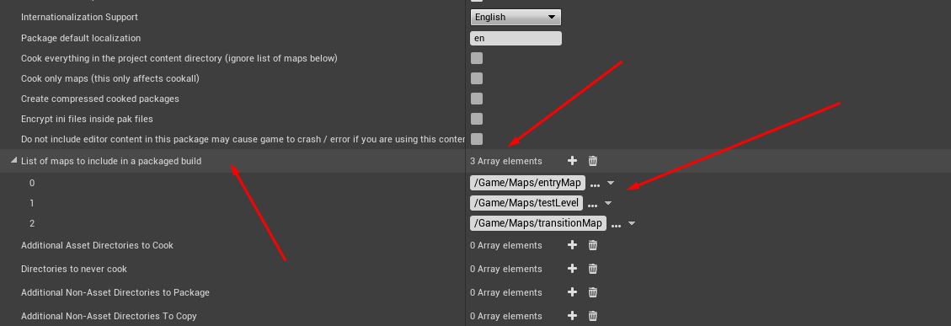

Slide 25
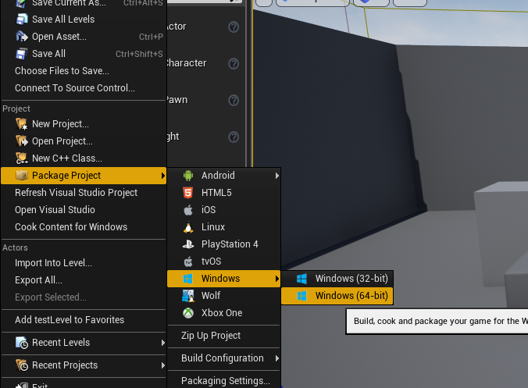

Slide 26
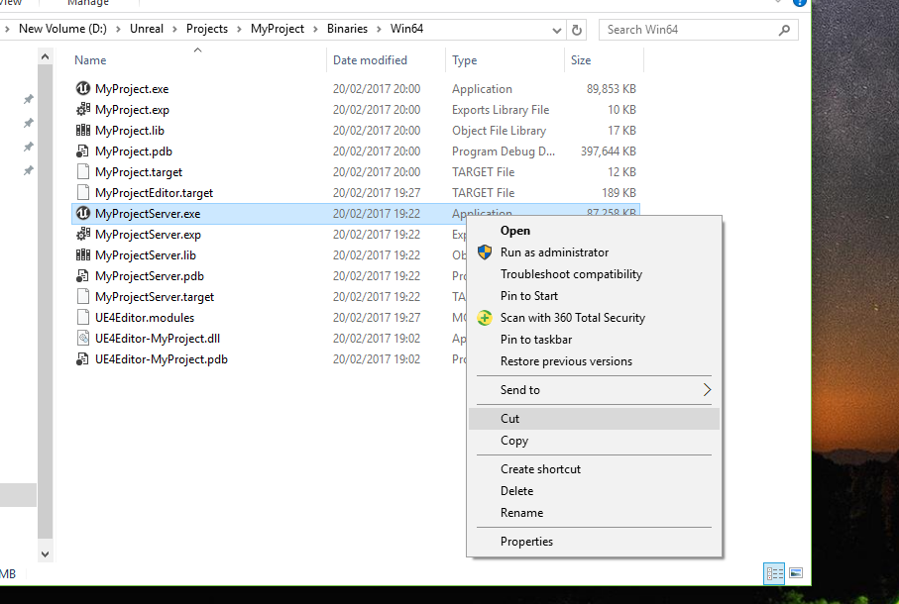

Slide 27
Compile the project

Slide 28
Compile the project

Slide 29
Compile the project

Slide 30
HOMEWORK

Slide 31
reference
https://wiki.unrealengine.com/Dedicated_Server_Guide_%28Windows_%26_Linux%29#Section_4_notes
https://docs.unrealengine.com/en-us/Platforms/Linux/GettingStarted
https://docs.unrealengine.com/en-us/Programming/Deployment/UsinganInstalledBuild
https://forums.unrealengine.com/development-discussion/engine-source-github/1397253-user-guide-building-standalone-unreal-engine-4-for-internal-distrubution-win64-linux

Slide 32
Source
https://github.com/Koous61/unreal-course

